Slide 1
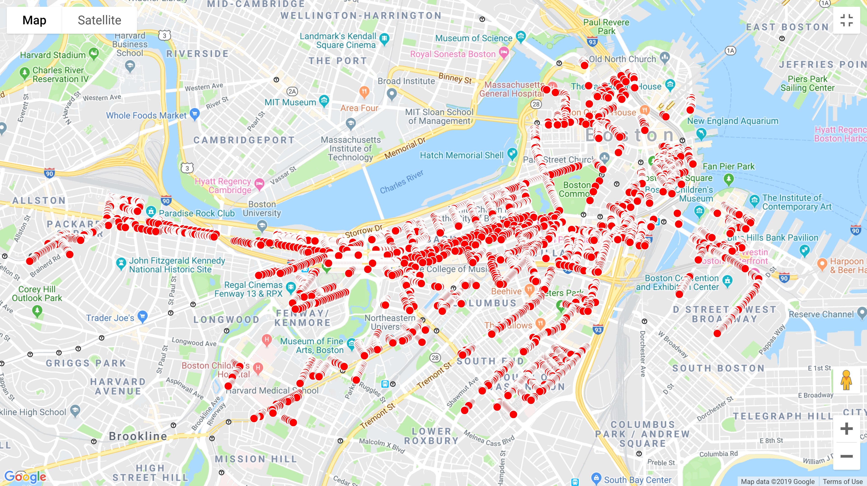


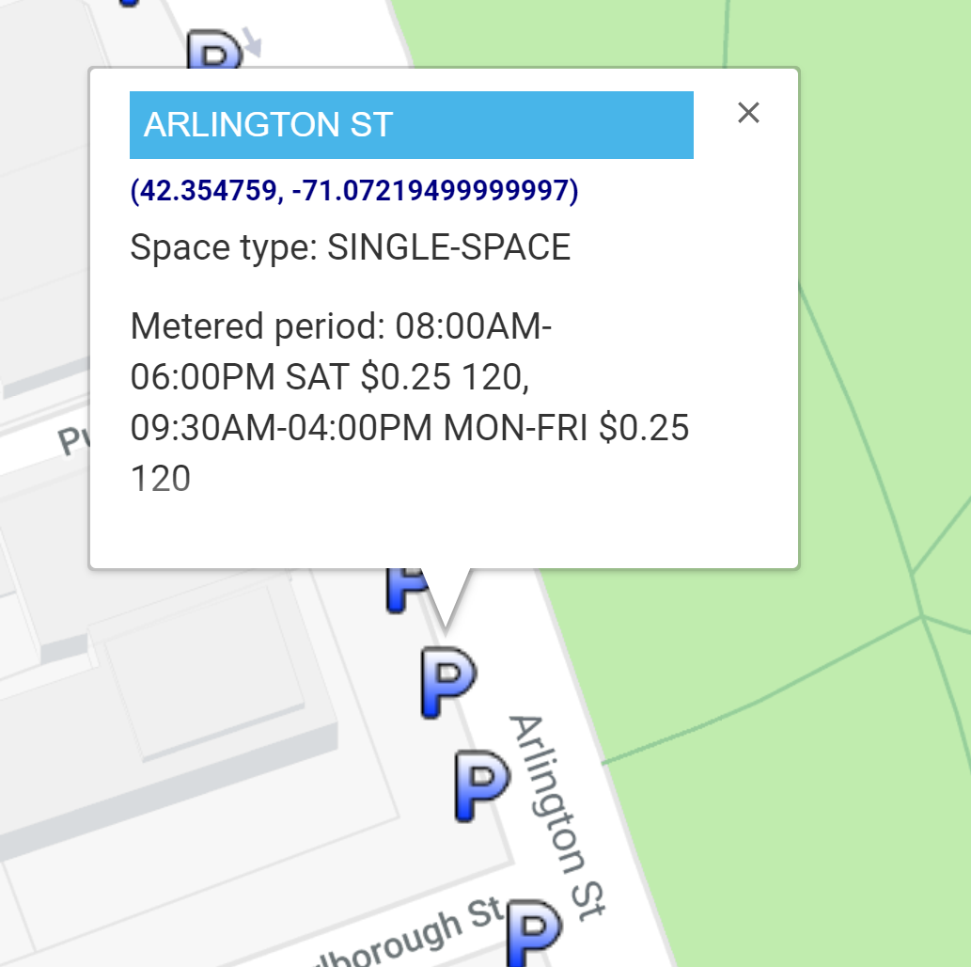
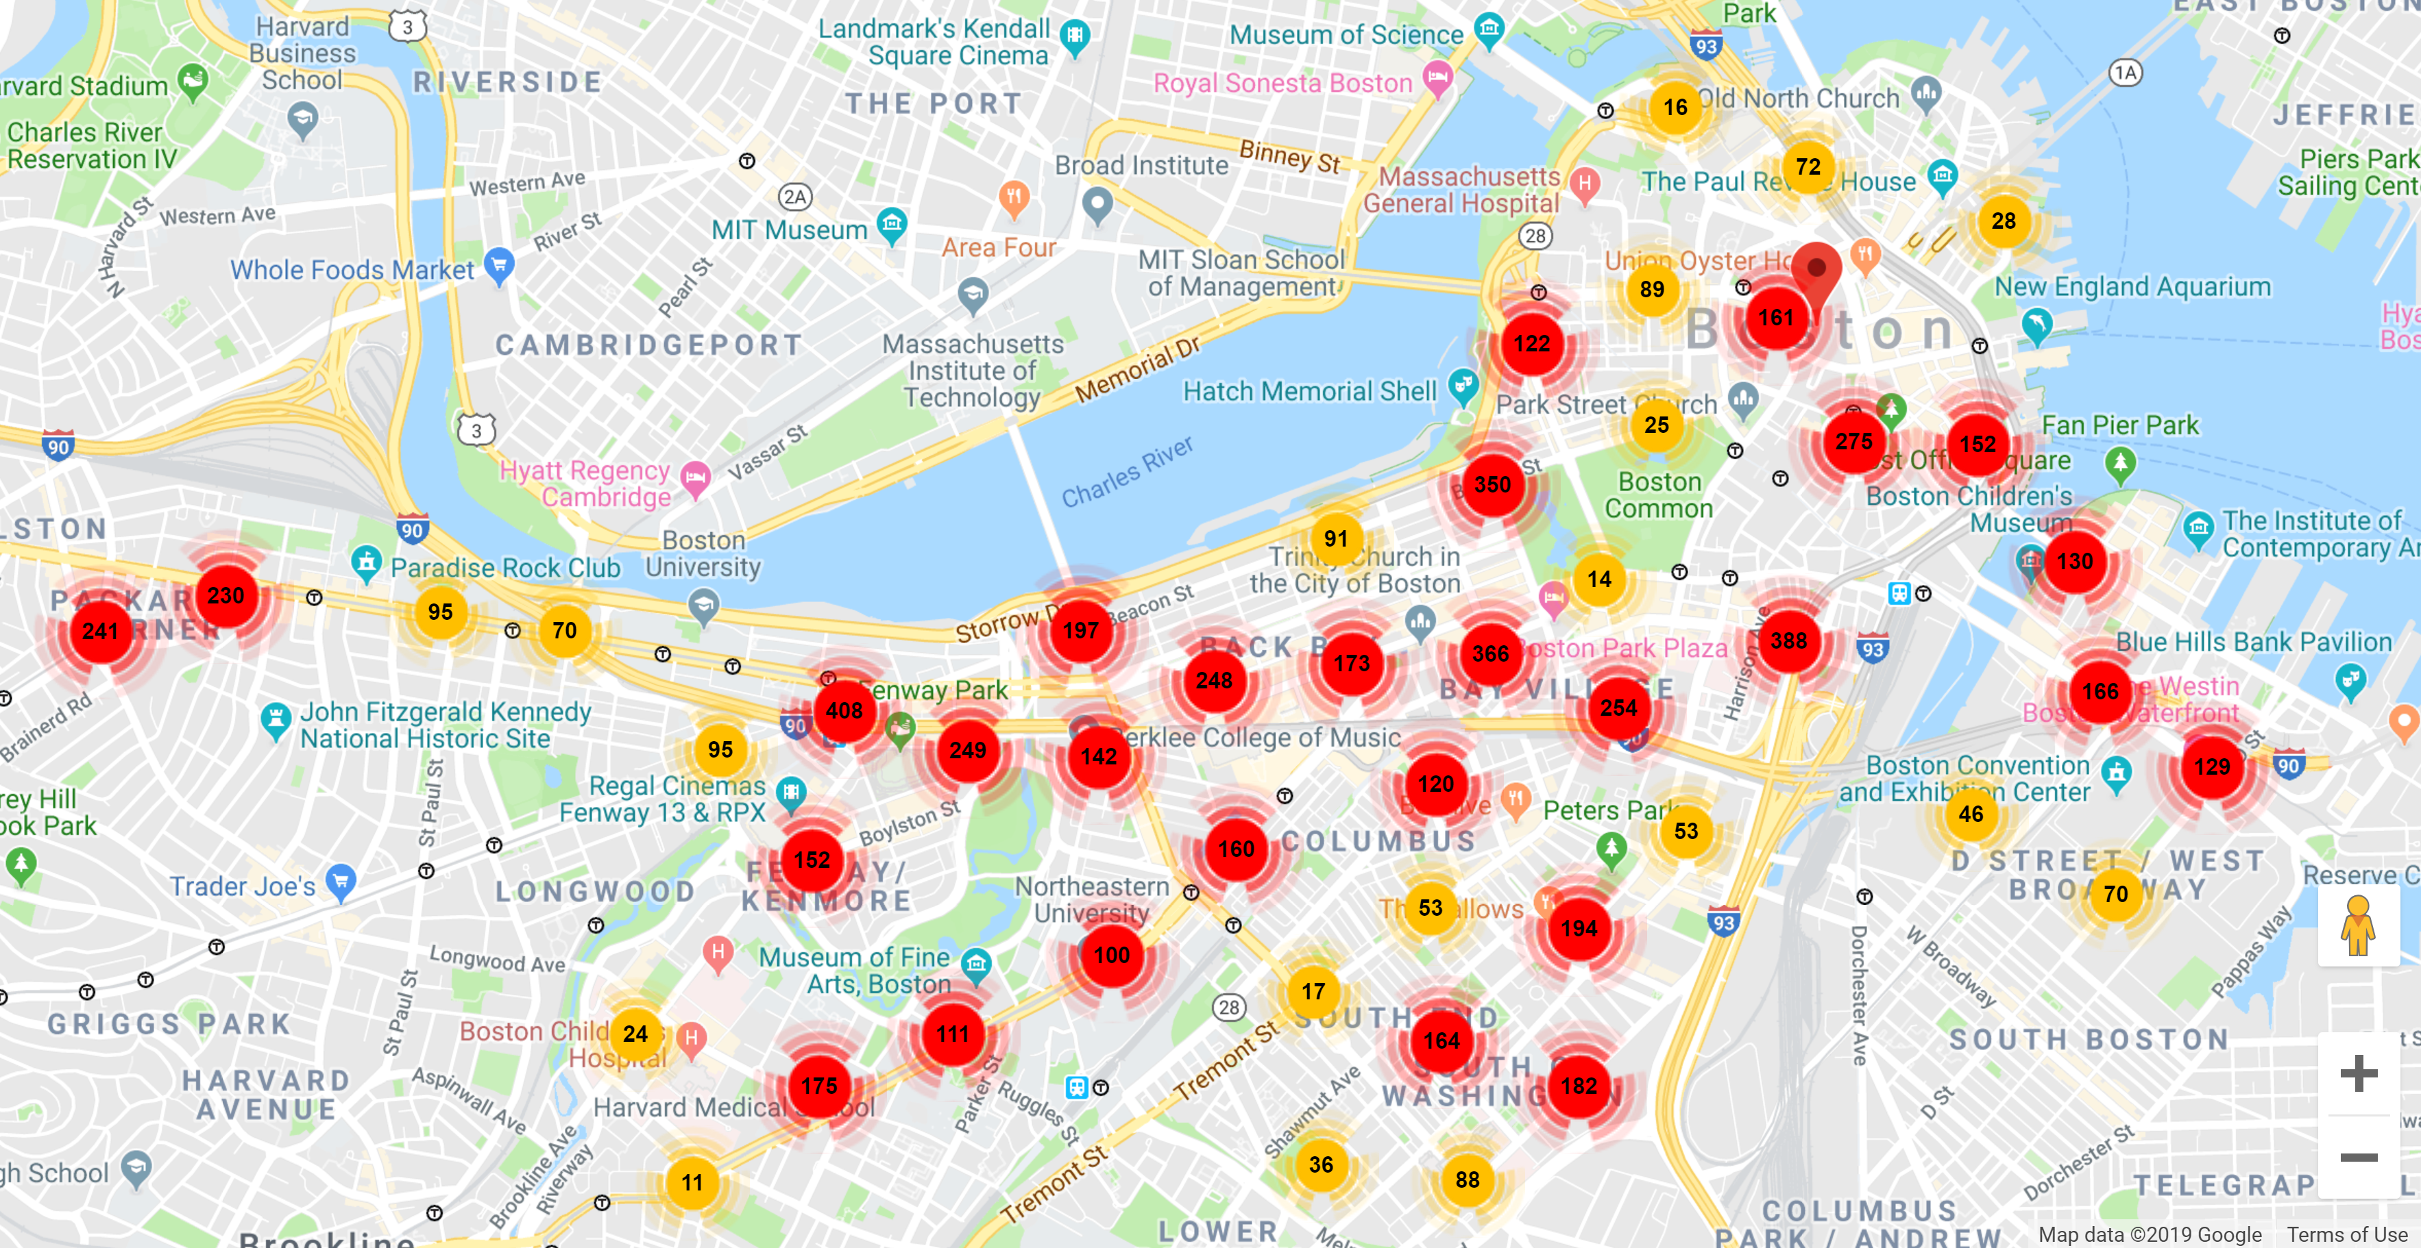

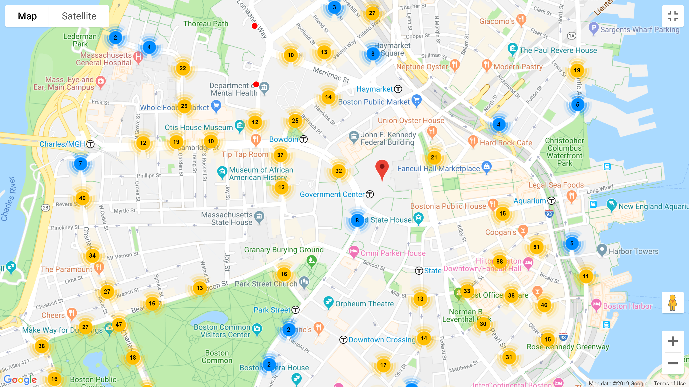
Boston, Big Data, and Web Technologies
Google Maps API
Google Maps API (Application Platform Interface) is a development tool that allow developers to customize map visualization and interaction. As the project centers on plotting coordinates of parking meters, the main tools utilized are creating markers onto the map, integrating existing markers under clusters, and showing information about each parking meter for users’ readability.
ABSTRACT
EXTRACT DATA
InfoWindow
INTERACTIVE MAP
To allow users to know more about a parking space other than the time that it is free, a pop-up window will appear upon clicking the marker. Useful information such as the space type and metered period will help users have an easier time choosing the right parking space.
Big Data Problems
Initial plotting of about 7000 parking spaces created tremendous lagging of nearly 7 seconds for each movement. The overlapping markers interfered with users’ understanding of the actual number of available parking in any particular region.
EXPLAIN DATA
Uyen Nguyen is a first-year undergraduate at Massachusetts Institute of Technology(MIT), aspiring to major in Electrical Engineering and Computer Science. She developed the Google maps platform for this project. Currently, she is also programming for the MIT Solar Electric Vehicle Team. She is a proud and active veteran of FIRST Robotics and VEX Robotics.
Marker Clustering
Grouping markers into clusters helps computers keep better track of all the markers’ location by assigning markers to specific regions. Depending on the zoom level, the clusters will merge or break up into other clusters to represent the general region. The number label on each marker cluster tells users the number of available parking of a particular area.

